Slide 1





ICTs for Effective Weather The Weather Information Dissemination System (WIDS) Where we came from and where we expect to go
Final Locate Dissemination Workshop – 11th March 2021

Slide 2
Outline
Background
Stakeholder Needs and Concerns
The role of ICT in Information Dissemination
What is WIDS?
Demand
Way Forward
Acknowledgement

Slide 3
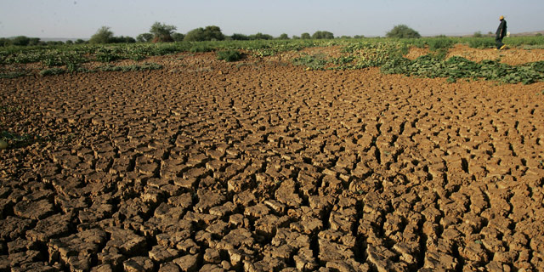
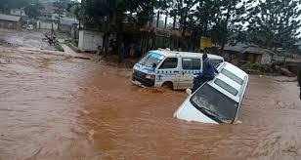
Background
Increased variation of weather events
Loss of lives, damage to property and financial losses
Accurate and timely weather info. Paramount
Weather info. Generated, However, is reaching a few
Need to improve dissemination
ICT Solution:
Timely and effective Info. dissemination
Wide coverage
Custom requests – time & Preference

Slide 4
ICT in Information Dissemination
Ease in disseminating information
Increase reach/ Wide coverage- Number of people
Improved access
Customized requests – Time and content
Affordability
Flexibility in customization

Slide 5
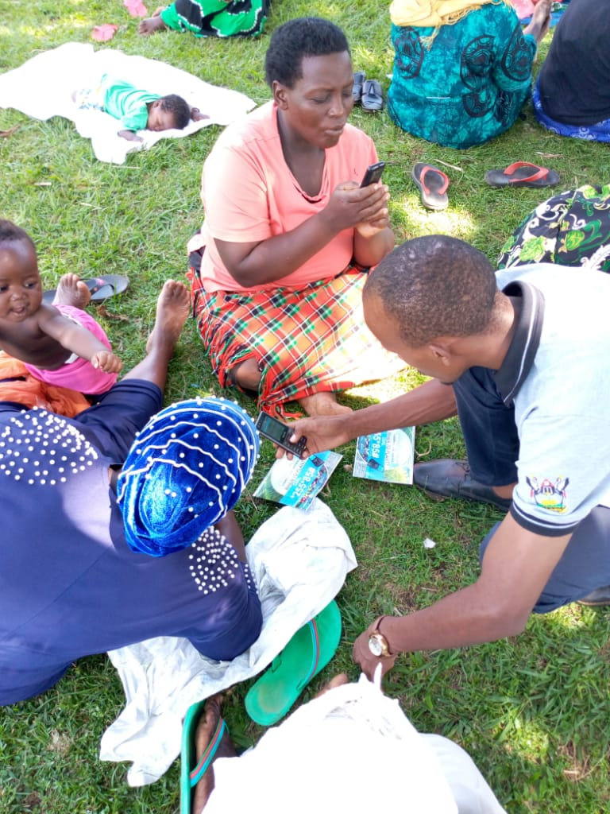
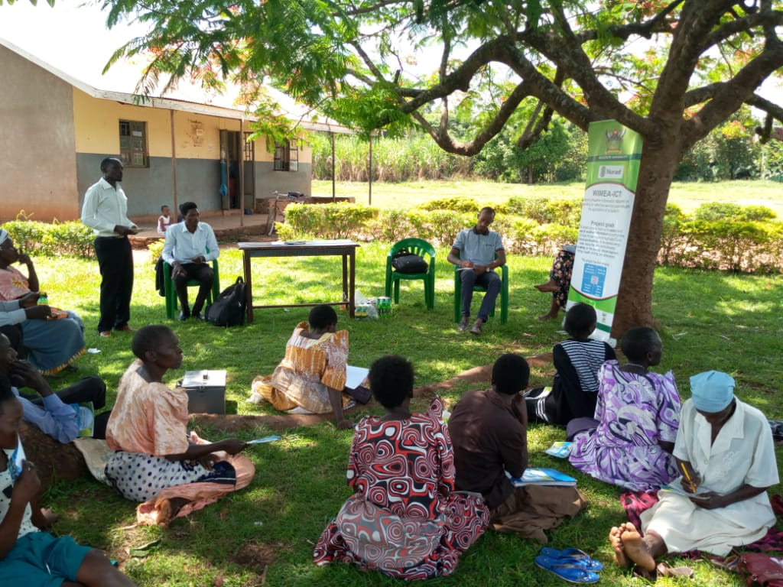
Stakeholder Needs and Concerns
Weather Information
Timeliness
Accuracy
Literacy levels
Limited access
Resource Limitations
Internet
Devices

Slide 6
What is WIDS?
Weather Information Dissemination System (WIDS)
Developed by WIMEA-ICT project, in collaboration UNMA
Furnished with weather products from UNMA
Disseminates weather information using
USSD Mobile application (*255*85#) – for all types of phones – Pull requests at a fee (approx. UGX 160 – 300)
Web portal – (http://wids.mak.ac.ug/wids )

Slide 7
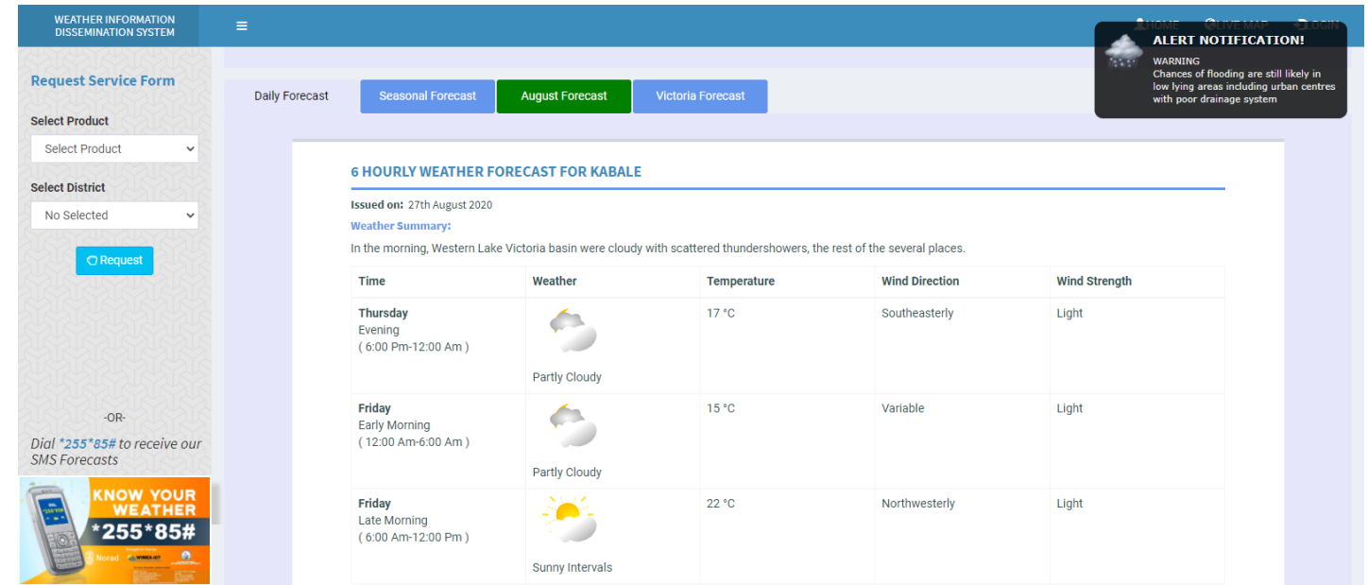
Web Portal
Information entry
Management
Warnings
Detailed Info.
Feedback
*255*85# or http://wids.mak.ac.ug/wids/

Slide 8
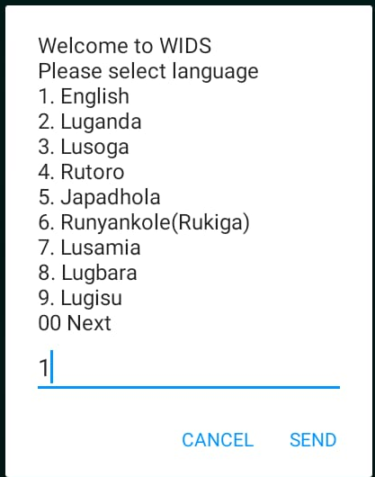
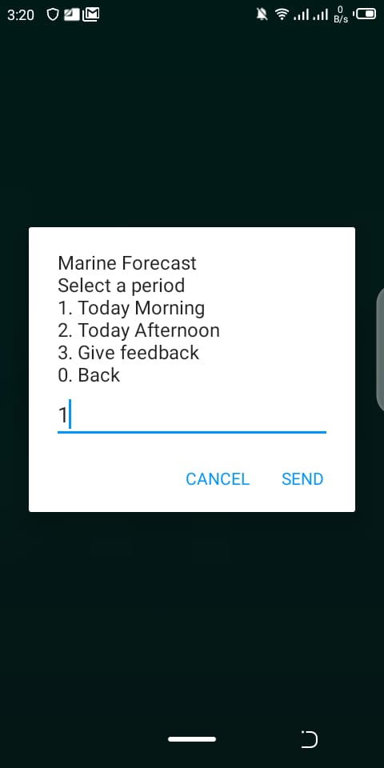
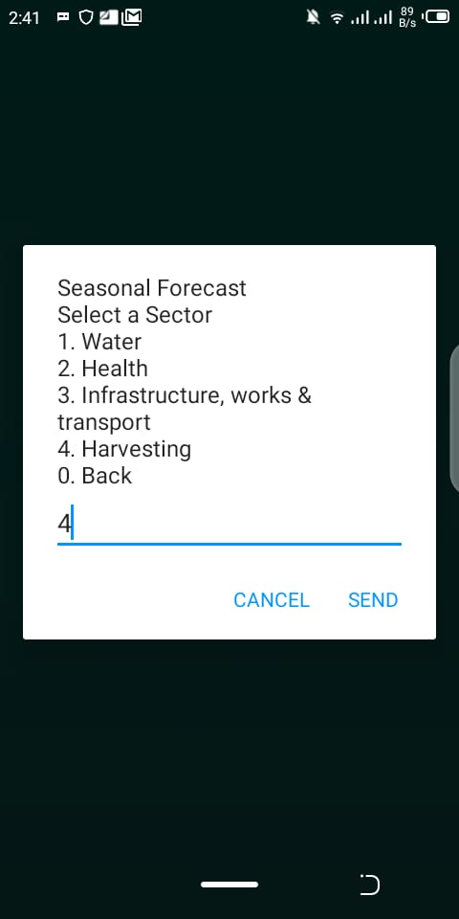
Features
Products
Daily Forecasts
Seasonal
marine Forecasts / Lake Victoria
Advisories – What to do
USSD Response
Response Formats:
Text messages
Audio
Languages

Slide 9
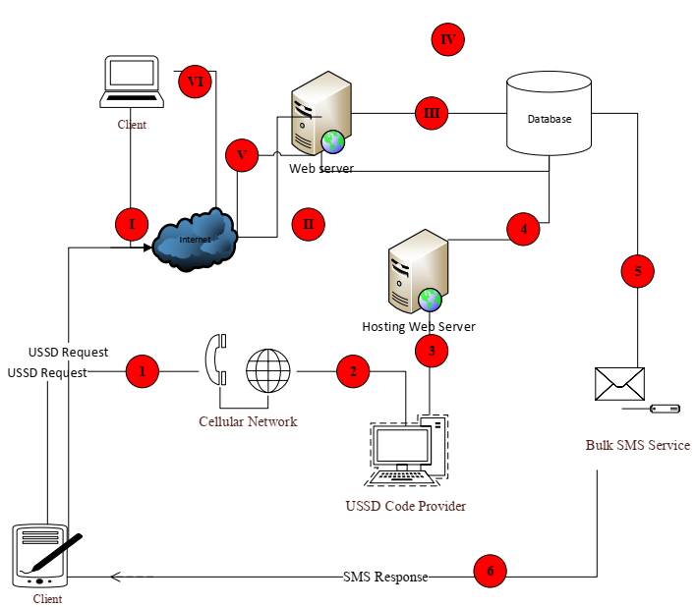
The Design

Slide 10
Stakeholders
Funders –NORAD, World Vision, Mak-RIF through Government of Uganda and others
WIMEA-ICT team
UNMA
ICT Players- Innovators, Bulk SMS providers, Hosting services, UCC, Telecom services
Researchers and academic institutions
Agricultural organizations
Other Government agencies – For Policies
Weather data consumers
Media –dissemination of weather information
Communities – using the weather information

Slide 11
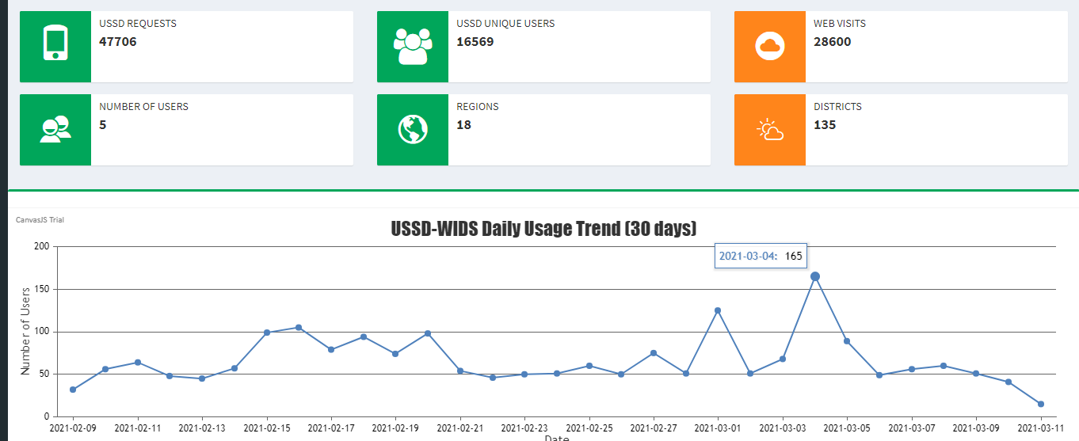
What is the demand?
*255*85# or http://wids.mak.ac.ug/wids/

Slide 12
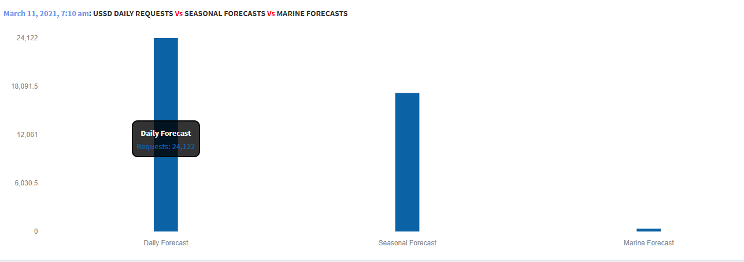
Products Demand

Slide 13
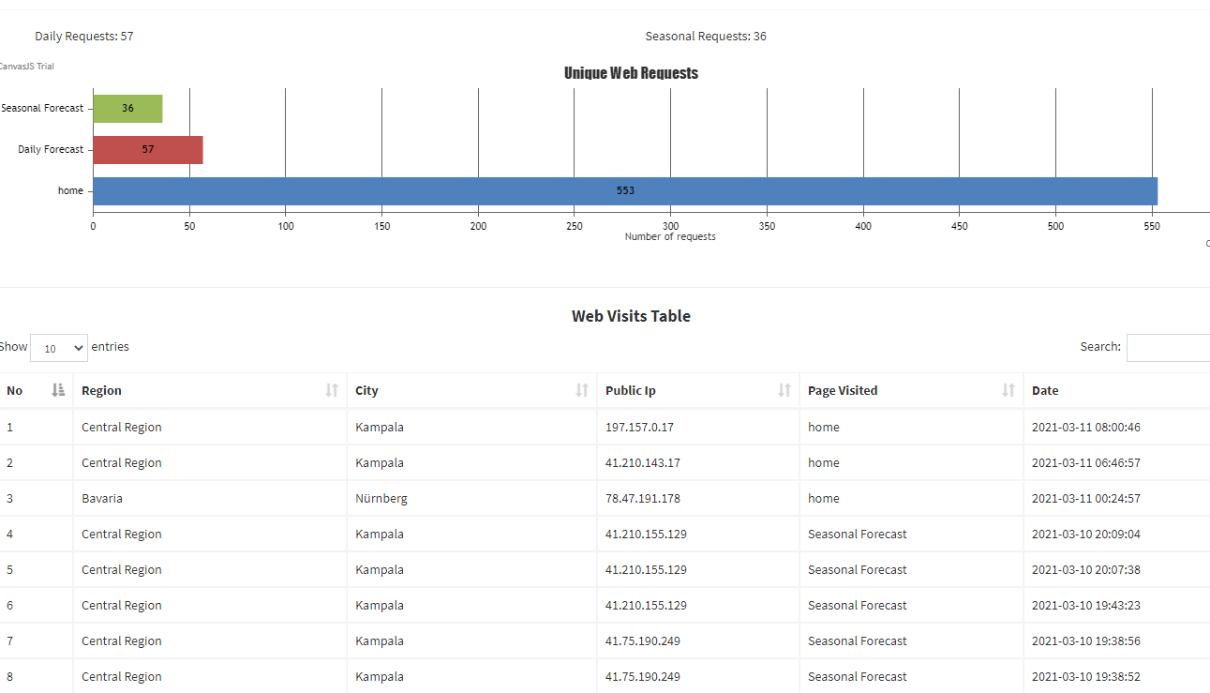
Web Visits

Slide 14
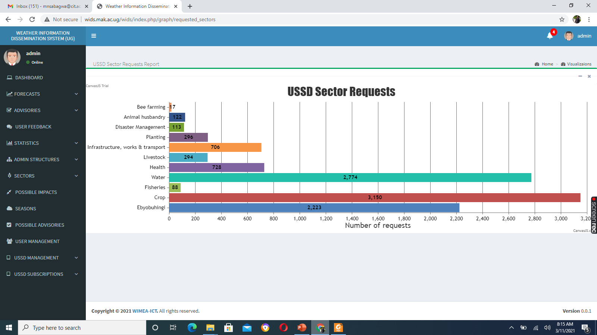

Slide 15
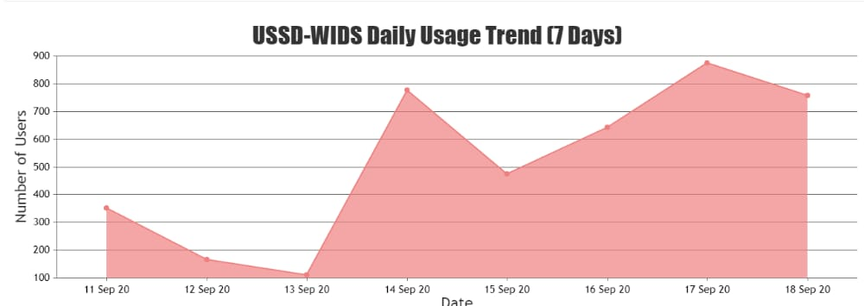
Visits per sector
Northern Uganda subscriptions | Time
322 | 7:47pm
752 | 11:58pm

Slide 16
Challenges
Incorporating additional functionality
Language translations – Limited capacity and High cost
WIDS Low awareness
Data entry
Cost of access for some people

Slide 17
Way Forward
Complete hand over to UNMA
Offer Professional assistance where need be
Promote WIDS in communities
Plans to improve where we can
Negotiations with government to make it a public good
Community engagement in translations and dissemination
Strengthening collaborations amongst sectors

Slide 18
Acknowledgement
Funders – NORAD, Government of Uganda through RIF
WIMEA-ICT Community and especially developers
All stakeholders

Slide 19
THANK YOU

